Slide 1
Retail Store Database Management System
Group 4:
Diksha Vinodkumar Desai
Sai Suresh Kale
Sayali Sambhaji Pathare
Shiva Mahitha Maddi
Abhilash Sunil Wase

Slide 2
Mission Statement
The purpose of Retail Database Management System is to amplify the efficiency, sales and quality of the Retail Store services.
It will simplify the process of maintaining data related to the inventory trends, orders, customers, employee management and finances.
This system will not only help to overcome the manual errors but also keeps the store organized for better customer service.

Slide 3
Business Problems Addressed
Allow retail store administration to check in-store stock availability
Maintains history of the orders
Managing assets and suppliers
Generates order reports to know which products are driving revenue

Slide 4
Main Entities Involved
Store
Customer
Employee
Product
Order
Supplier
Promotions
Invoice

Slide 5
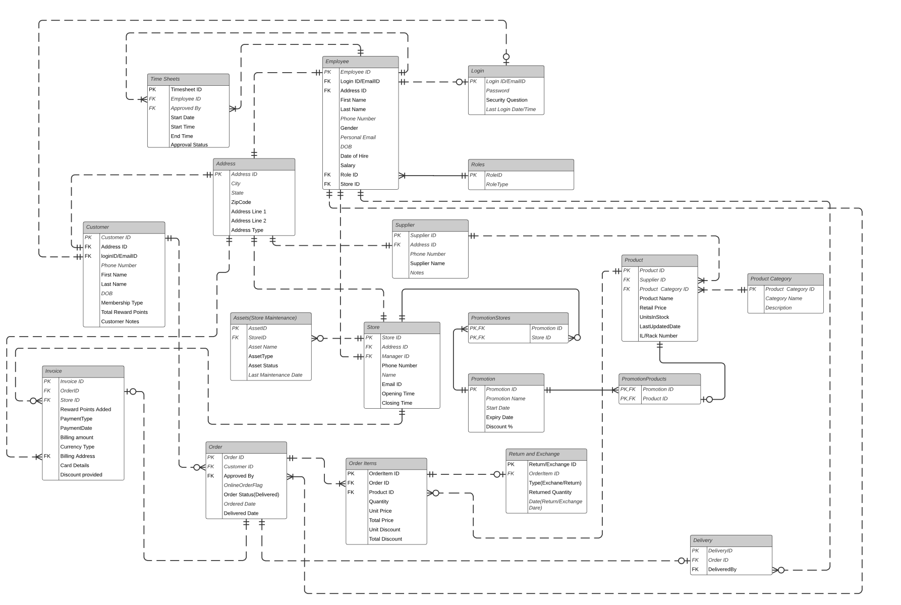
E-R Diagram

Slide 6
Functionalities Implemented
DDL
Stored Procedures
Data Encryption
Computed Columns
Functions
Triggers
Views

Slide 7
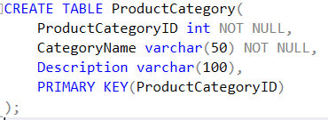
DDL Statements
CREATE TABLE
ALTER TABLE
ALTER TABLE Product ALTER COLUMN RackNumber varchar(10);
DROP PROCEDURE
DROP PROCEDURE PromotionStoresProcedure;

Slide 8
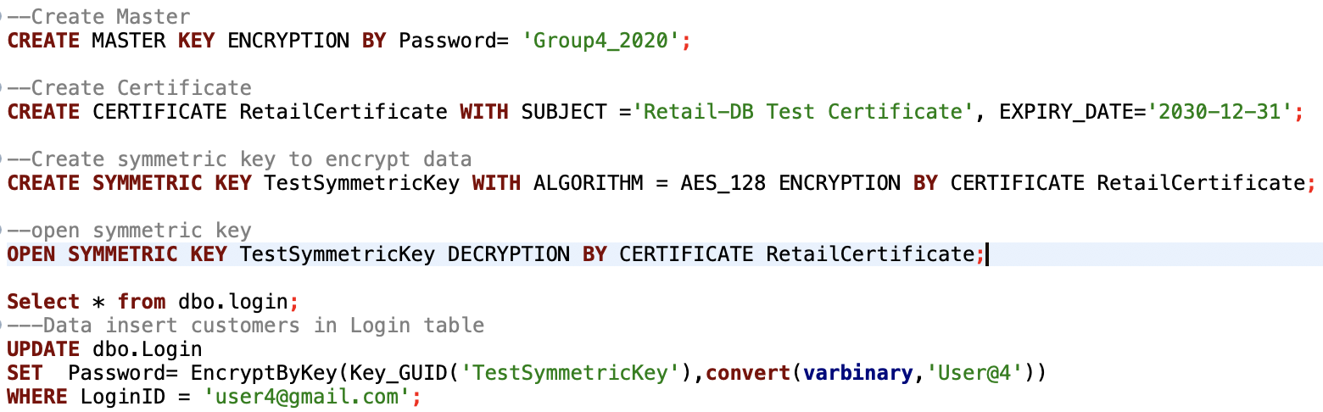
Functionalities
Column Data Encryption (Login Table-Password)

Slide 9
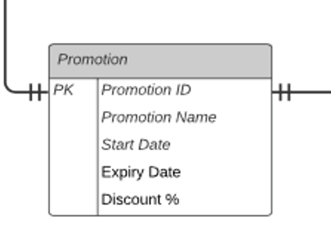
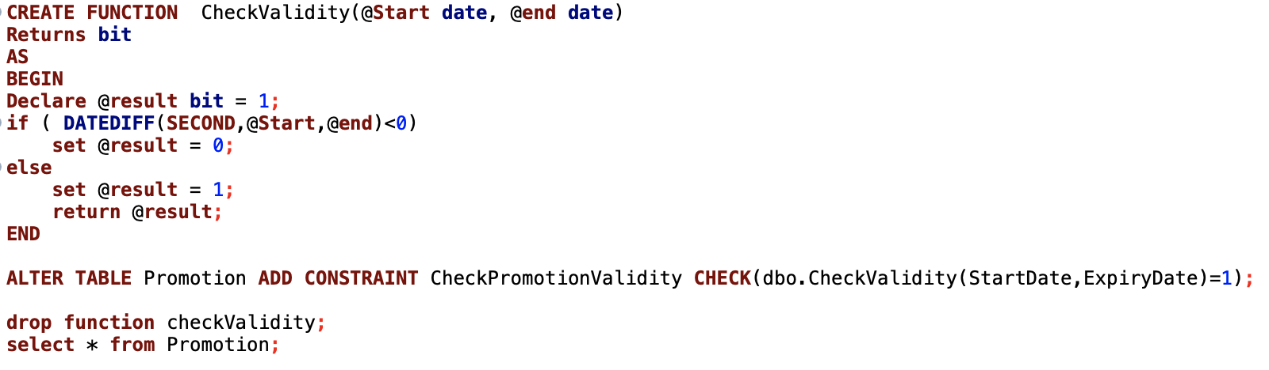
Functionalities
Table-level CHECK Constraints based on a function

Slide 10
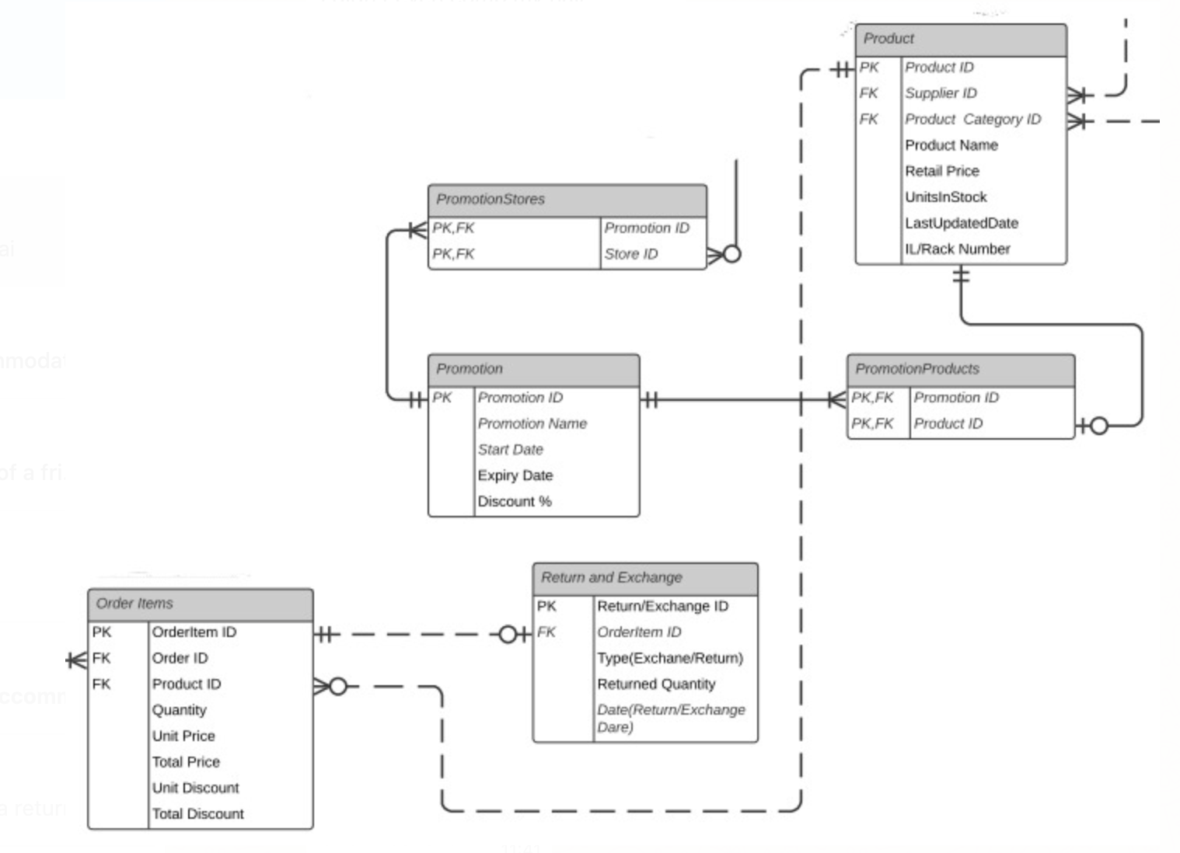
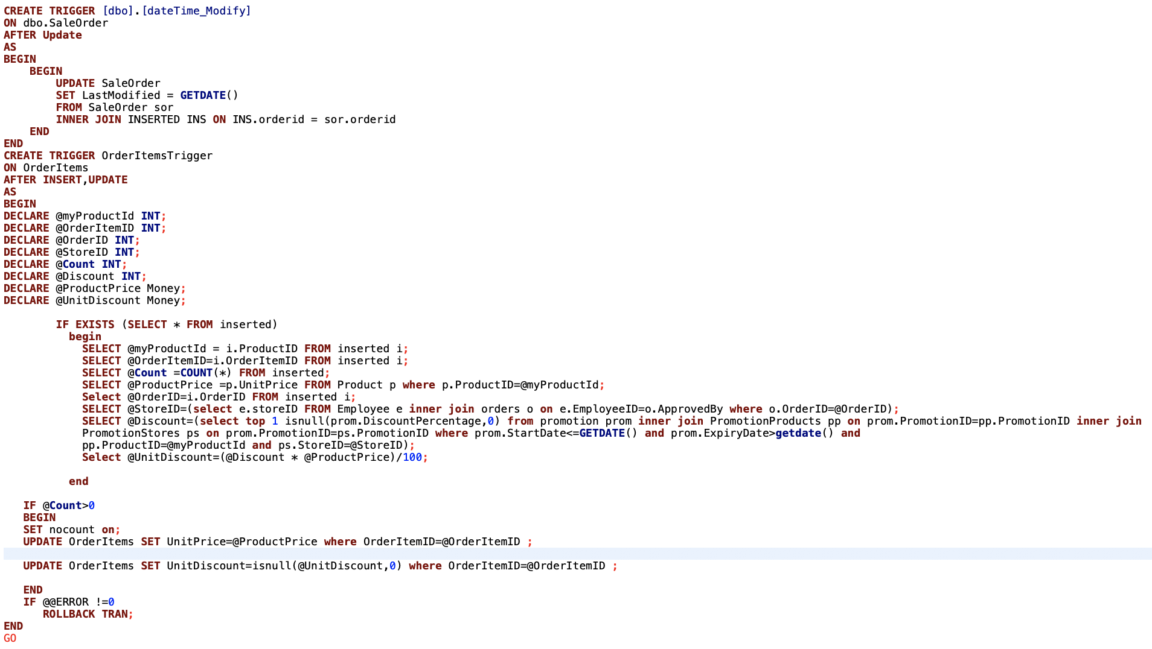
Functionalities
Trigger 1

Slide 11
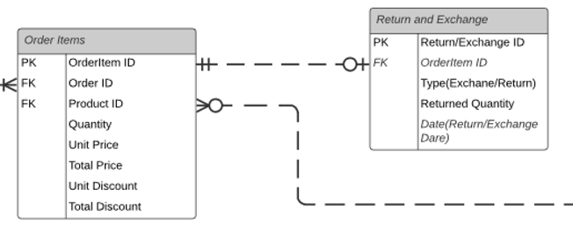
Functionalities
Trigger 2
CREATE TRIGGER ReturnAndExchangeTrigger
ON ReturnAndExchange
AFTER INSERT,UPDATE
AS
BEGIN
DECLARE @myOrderItemId INT;
DECLARE @Count INT;
DECLARE @QuantityReturned INT;
IF EXISTS (SELECT * FROM inserted)
begin
SELECT @myOrderItemId = i.OrderItemID FROM inserted i;
SELECT @Count =COUNT(*) FROM inserted i where i.ReturnedType='return';
SELECT @QuantityReturned=i.ReturnedQuantity FROM inserted i;
end
IF @Count>0
BEGIN
SET nocount on;
UPDATE OrderItems SET Quantity= (Quantity-@QuantityReturned) where OrderItemID=@myOrderItemId; END
IF @@ERROR !=0
ROLLBACK TRAN;
END
GO

Slide 12
Views
CREATE VIEW [Stores With Highest Sales]
CREATE VIEW [Stores With today's Offer]
CREATE VIEW [Total Orders per Date]
CREATE VIEW [Total Quantity of Each Product Sold]
CREATE VIEW [Total Sales Per City]

Slide 13
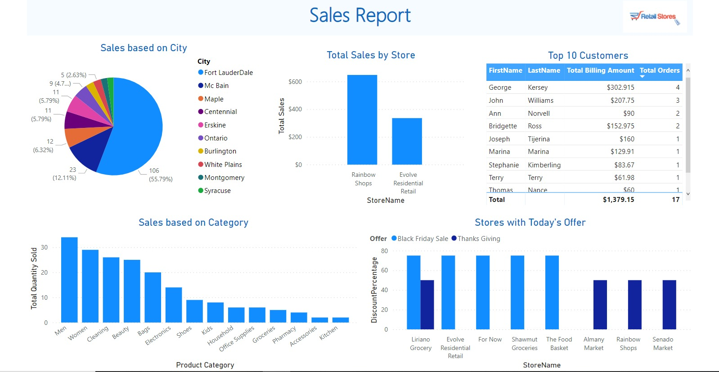
Data Visualizations

Slide 14

Thank you

